Slide 1

Choosing the best model
Felipe Buchbinder

Slide 2
Models we’ve seen so far
Pooled Regression (PR)
First Differences (FD)
Fixed Effects (FE)
Random Effects (RE)
Quasi-Demeaning (QD) + Cochrane-Orcutt, Prais-Winsten and Hildreth-Lu (CO/PW/HL)

Slide 3
Start simple: pooled regression
Pooled Regression

Slide 4

Run a Breusch-Pagan Lagrange Multiplier test. If you reject $H_{0}$, do a random effects model instead.
Pooled Regression
Random Effects
Breusch-Pagan LM test

Slide 5

Run a HAUSMAN test. If you reject $H_{0}$, do a Fixed effects model instead.
Pooled Regression
Random Effects
Breusch-Pagan LM test
Hausman test
Fixed Effects

Slide 6

Run a Breusch-Godfrey test or a Durbin-Whatson test. If you reject $H_{0}$, do a First difference model instead.
Pooled Regression
Random Effects
Breusch-Pagan LM test
Hausman test
First Difference
Fixed Effects
Breusch-Godfrey test
Durbin-Whatson test

Slide 7
Run a Breusch-Godfrey test or a Durbin-Whatson test AGAIN, this time on your First difference model.
Pooled Regression
Random Effects
Breusch-Pagan LM test
Hausman test
First Difference
Fixed Effects
Breusch-Godfrey test
Durbin-Whatson test

Slide 8

If you reject $H_{0}$, use quasi-differentiation to achieve serially uncorrelated residuals
Pooled Regression
Random Effects
Breusch-Pagan LM test
Hausman test
First Difference
Fixed Effects
Breusch-Godfrey test
Durbin-Whatson test
Breusch-Godfrey test
Durbin-Whatson test
Quasi-Demeaning +
Cochrane-Orcutt,
Prais-Winsten or
Hildreth-Lu

Slide 9
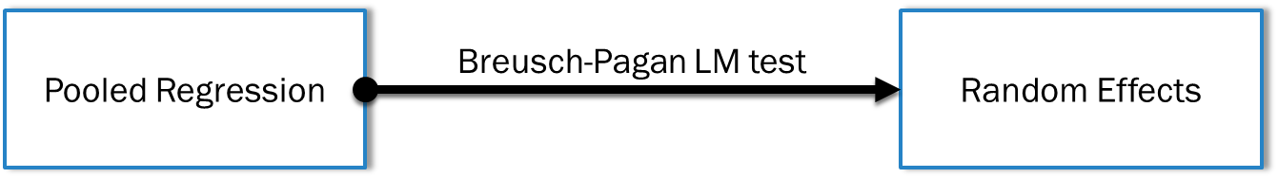
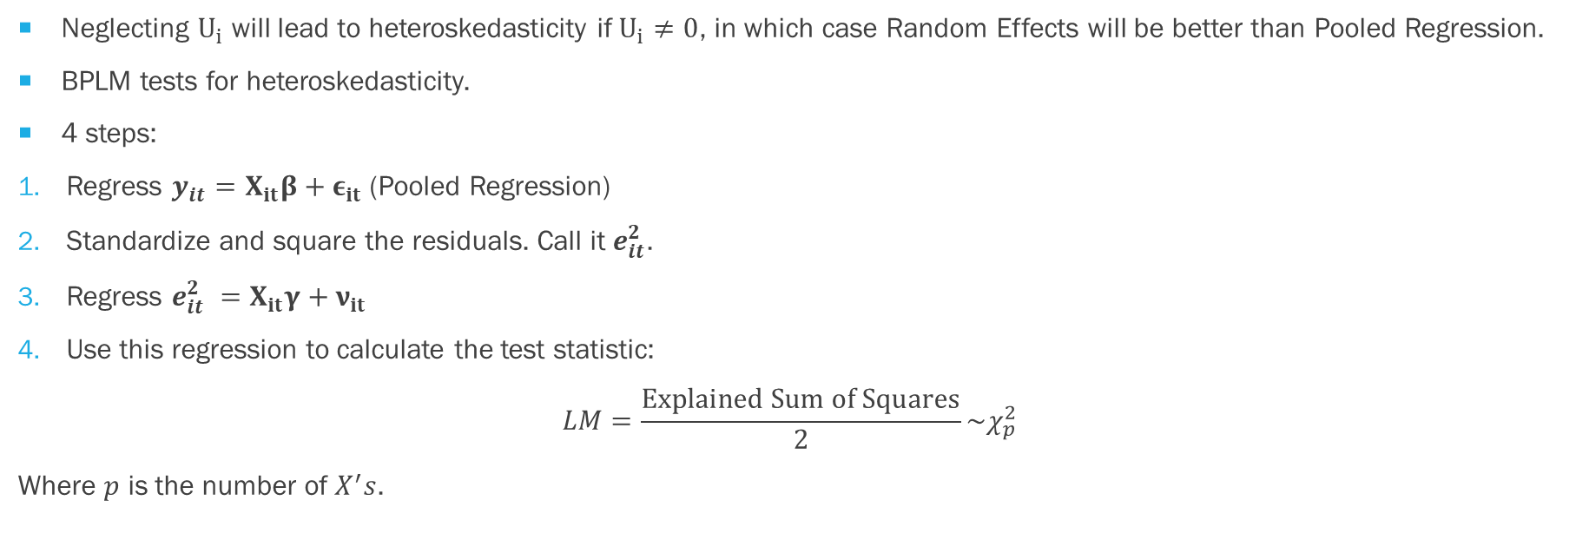
Breusch-Pagan LM Test
Neglecting $U_{i}$ will lead to heteroskedasticity if $U_{i}≠0$, in which case Random Effects will be better than Pooled Regression.
BPLM tests for heteroskedasticity.
4 steps:
Regress $y_{it}=X_{it}β+ε_{it}$ (Pooled Regression)
Standardize and square the residuals. Call it $e_{it}^{2}$.
Regress $e_{it}^{2} =X_{it}γ+ν_{it}$
Use this regression to calculate the test statistic:
$$LM=\frac{Explained Sum of Squares}{2}\sim χ_{p}^{2}$$
Where $p$ is the number of $X^{′}s$.

Slide 10
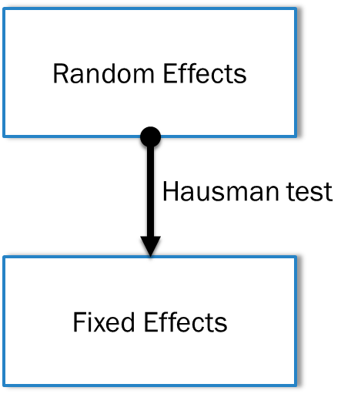
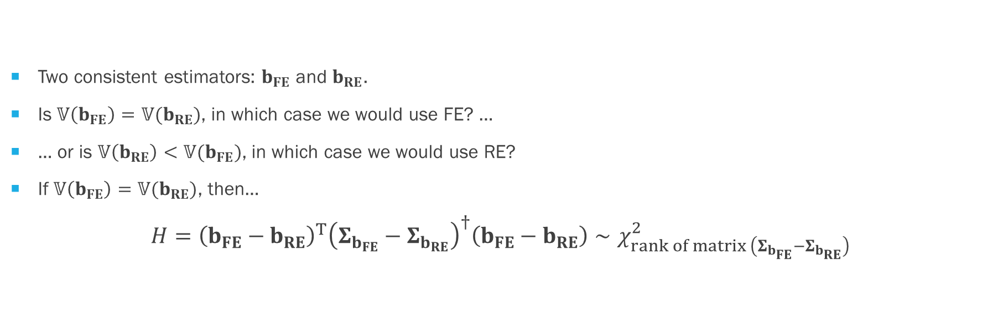
Hausman test
Two consistent estimators: $b_{FE}$ and $b_{RE}$.
Is $𝕍\left(b_{FE}\right)=𝕍(b_{RE})$, in which case we would use FE? …
… or is $𝕍\left(b_{RE}\right)<𝕍(b_{FE})$, in which case we would use RE?
If $𝕍\left(b_{FE}\right)=𝕍(b_{RE})$, then…
$$H={\left(b_{FE}−b_{RE}\right)}^{T}{\left(Σ_{b_{FE}}−Σ_{b_{RE}}\right)}^{†}\left(b_{FE}−b_{RE}\right)∼χ_{rank of matrix \left(Σ_{b_{FE}}−Σ_{b_{RE}}\right) }^{2}$$

Slide 11
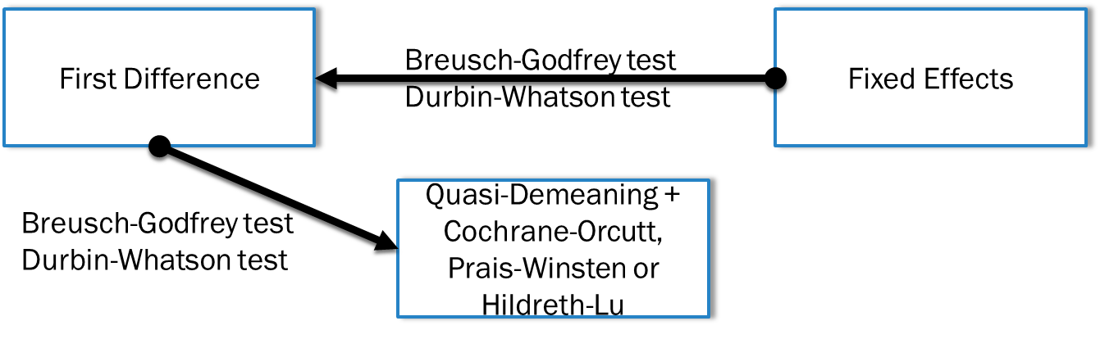
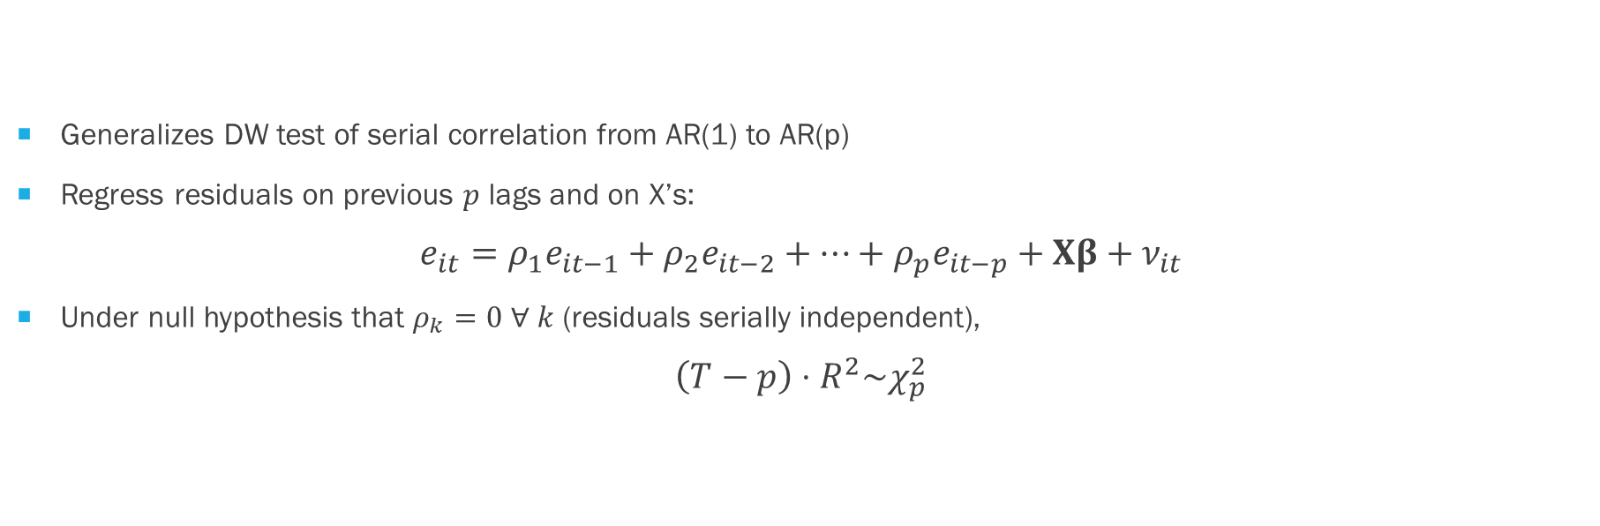
Breusch-Godfrey test
Generalizes DW test of serial correlation from AR(1) to AR(p)
Regress residuals on previous $p$ lags and on X’s:
$$e_{it}={ρ_{1}e}_{it−1}+{ρ_{2}e}_{it−2}+…+{ρ_{p}e}_{it−p}+Xβ+ν_{it}$$
Under null hypothesis that $ρ_{k}=0 ∀ k$ (residuals serially independent),
$$\left(T−p\right)⋅R^{2}\sim χ_{p}^{2}$$

Slide 12
Key Takeaway
Pooled Regression
Random Effects
Breusch-Pagan LM test
Hausman test
First Difference
Fixed Effects
Breusch-Godfrey test
Durbin-Whatson test
Breusch-Godfrey test
Durbin-Whatson test
Quasi-Demeaning +
Cochrane-Orcutt,
Prais-Winsten or
Hildreth-Lu

